Slide 1
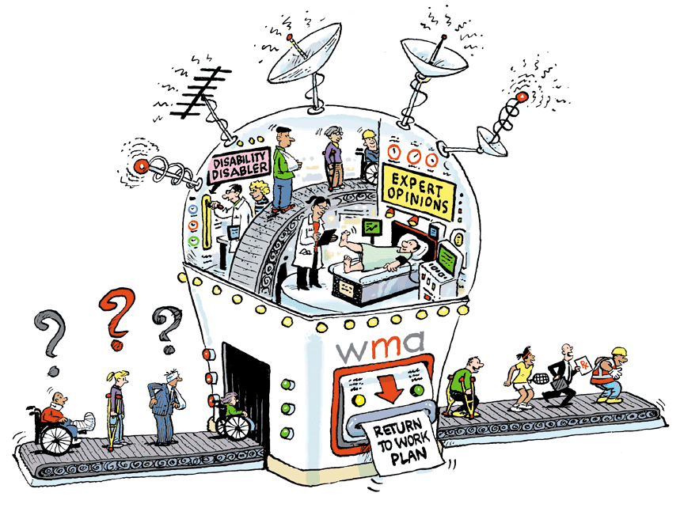

Slide 2
Getting Truckers Back to Work (and Potholes to Avoid!)
Dr. Roger Hodkinson
CEO/Medical Director
Western Medical Assessments
Edmonton

Slide 3
Stuff We’ll Cover
What is RTW?
Why is early RTW Important?
Management Options
Medical Assessments
Purposes
Types
When to use
WCB issues
Medicalization and how to avoid it
Narcotics and Marijuana abuse
The ‘3 Ps’
General Principles

Slide 5
What is Return To Work?
RTW: A planned process to manage the impact of disability
in a workplace
Sometimes alternate or modified work (temporary or permanent) is necessary with a progression to pre-injury work
Studies show the longer someone is off work, the less likely he or she is to ever return

Slide 6
Why is early RTW important?
Decreases lost time = $ saved
Improves productivity = $ saved
Reduces hiring/training costs = $ saved
Decreases WCB premium costs = $ saved
Decreases LTD insurance costs = $ saved
Enhances employee’s self-esteem = ☺
Enhances company’s integrity = ☺

Slide 7
Disability = $$$ Lost
$17 billion per year -- loss to Canada’s economy from absenteeism
-- Conference Board of Canada, 2013 --
Mental illness is the leading cause of disability in Canada
More than 500,000 Canadians miss work each week because of mental illness
Mental Illness causes:
More than 30 per cent of disability claims
More then 70 per cent of disability costs
Disability cost for mental illness is twice that of physical illness
-- Mental Health Commission of Canada --
Notes:
500,000 absences / week
• approximately 355,000 disability cases due to mental and/or behavioral disorders
• approximately 175,000 full-time workers absent from work due to mental illness

Slide 8
Mental Illness
Mental illness: leading cause of disability in Canada
More than 500,000 Canadians miss work each week because of mental illness
Mental Illness causes:
More than 30 per cent of disability claims
More then 70 per cent of disability costs
Disability cost for mental illness is twice that of physical illness
(Source: Mental Health Commission of Canada)
Notes:
500,000 absences / week
• approximately 355,000 disability cases due to mental and/or behavioral disorders
• approximately 175,000 full-time workers absent from work due to mental illness

Slide 9
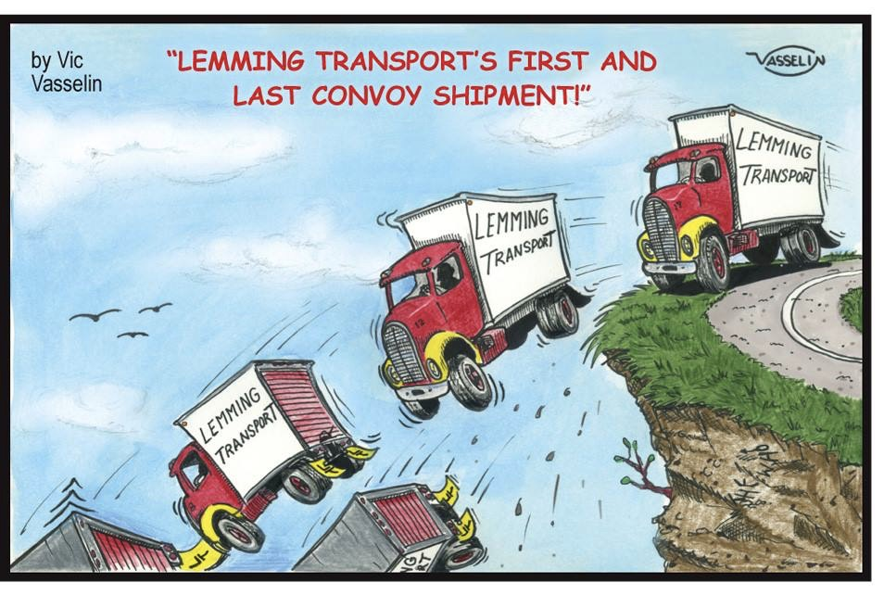
Notes:
500,000 absences / week
• approximately 355,000 disability cases due to mental and/or behavioral disorders
• approximately 175,000 full-time workers absent from work due to mental illness

Slide 10
“More important than the quest for certainty is the quest for clarity.” François Gautier

Slide 11
RTW: Option #1
Accept the Family Physician (GP) disability note at face-value
Is it plausible?
Is there an evidence-based program for RTW?
When contemplating RTW ask the GP:
Restrictions/limitations?
Is it safe?
Notes:
500,000 absences / week
• approximately 355,000 disability cases due to mental and/or behavioral disorders
• approximately 175,000 full-time workers absent from work due to mental illness

Slide 12
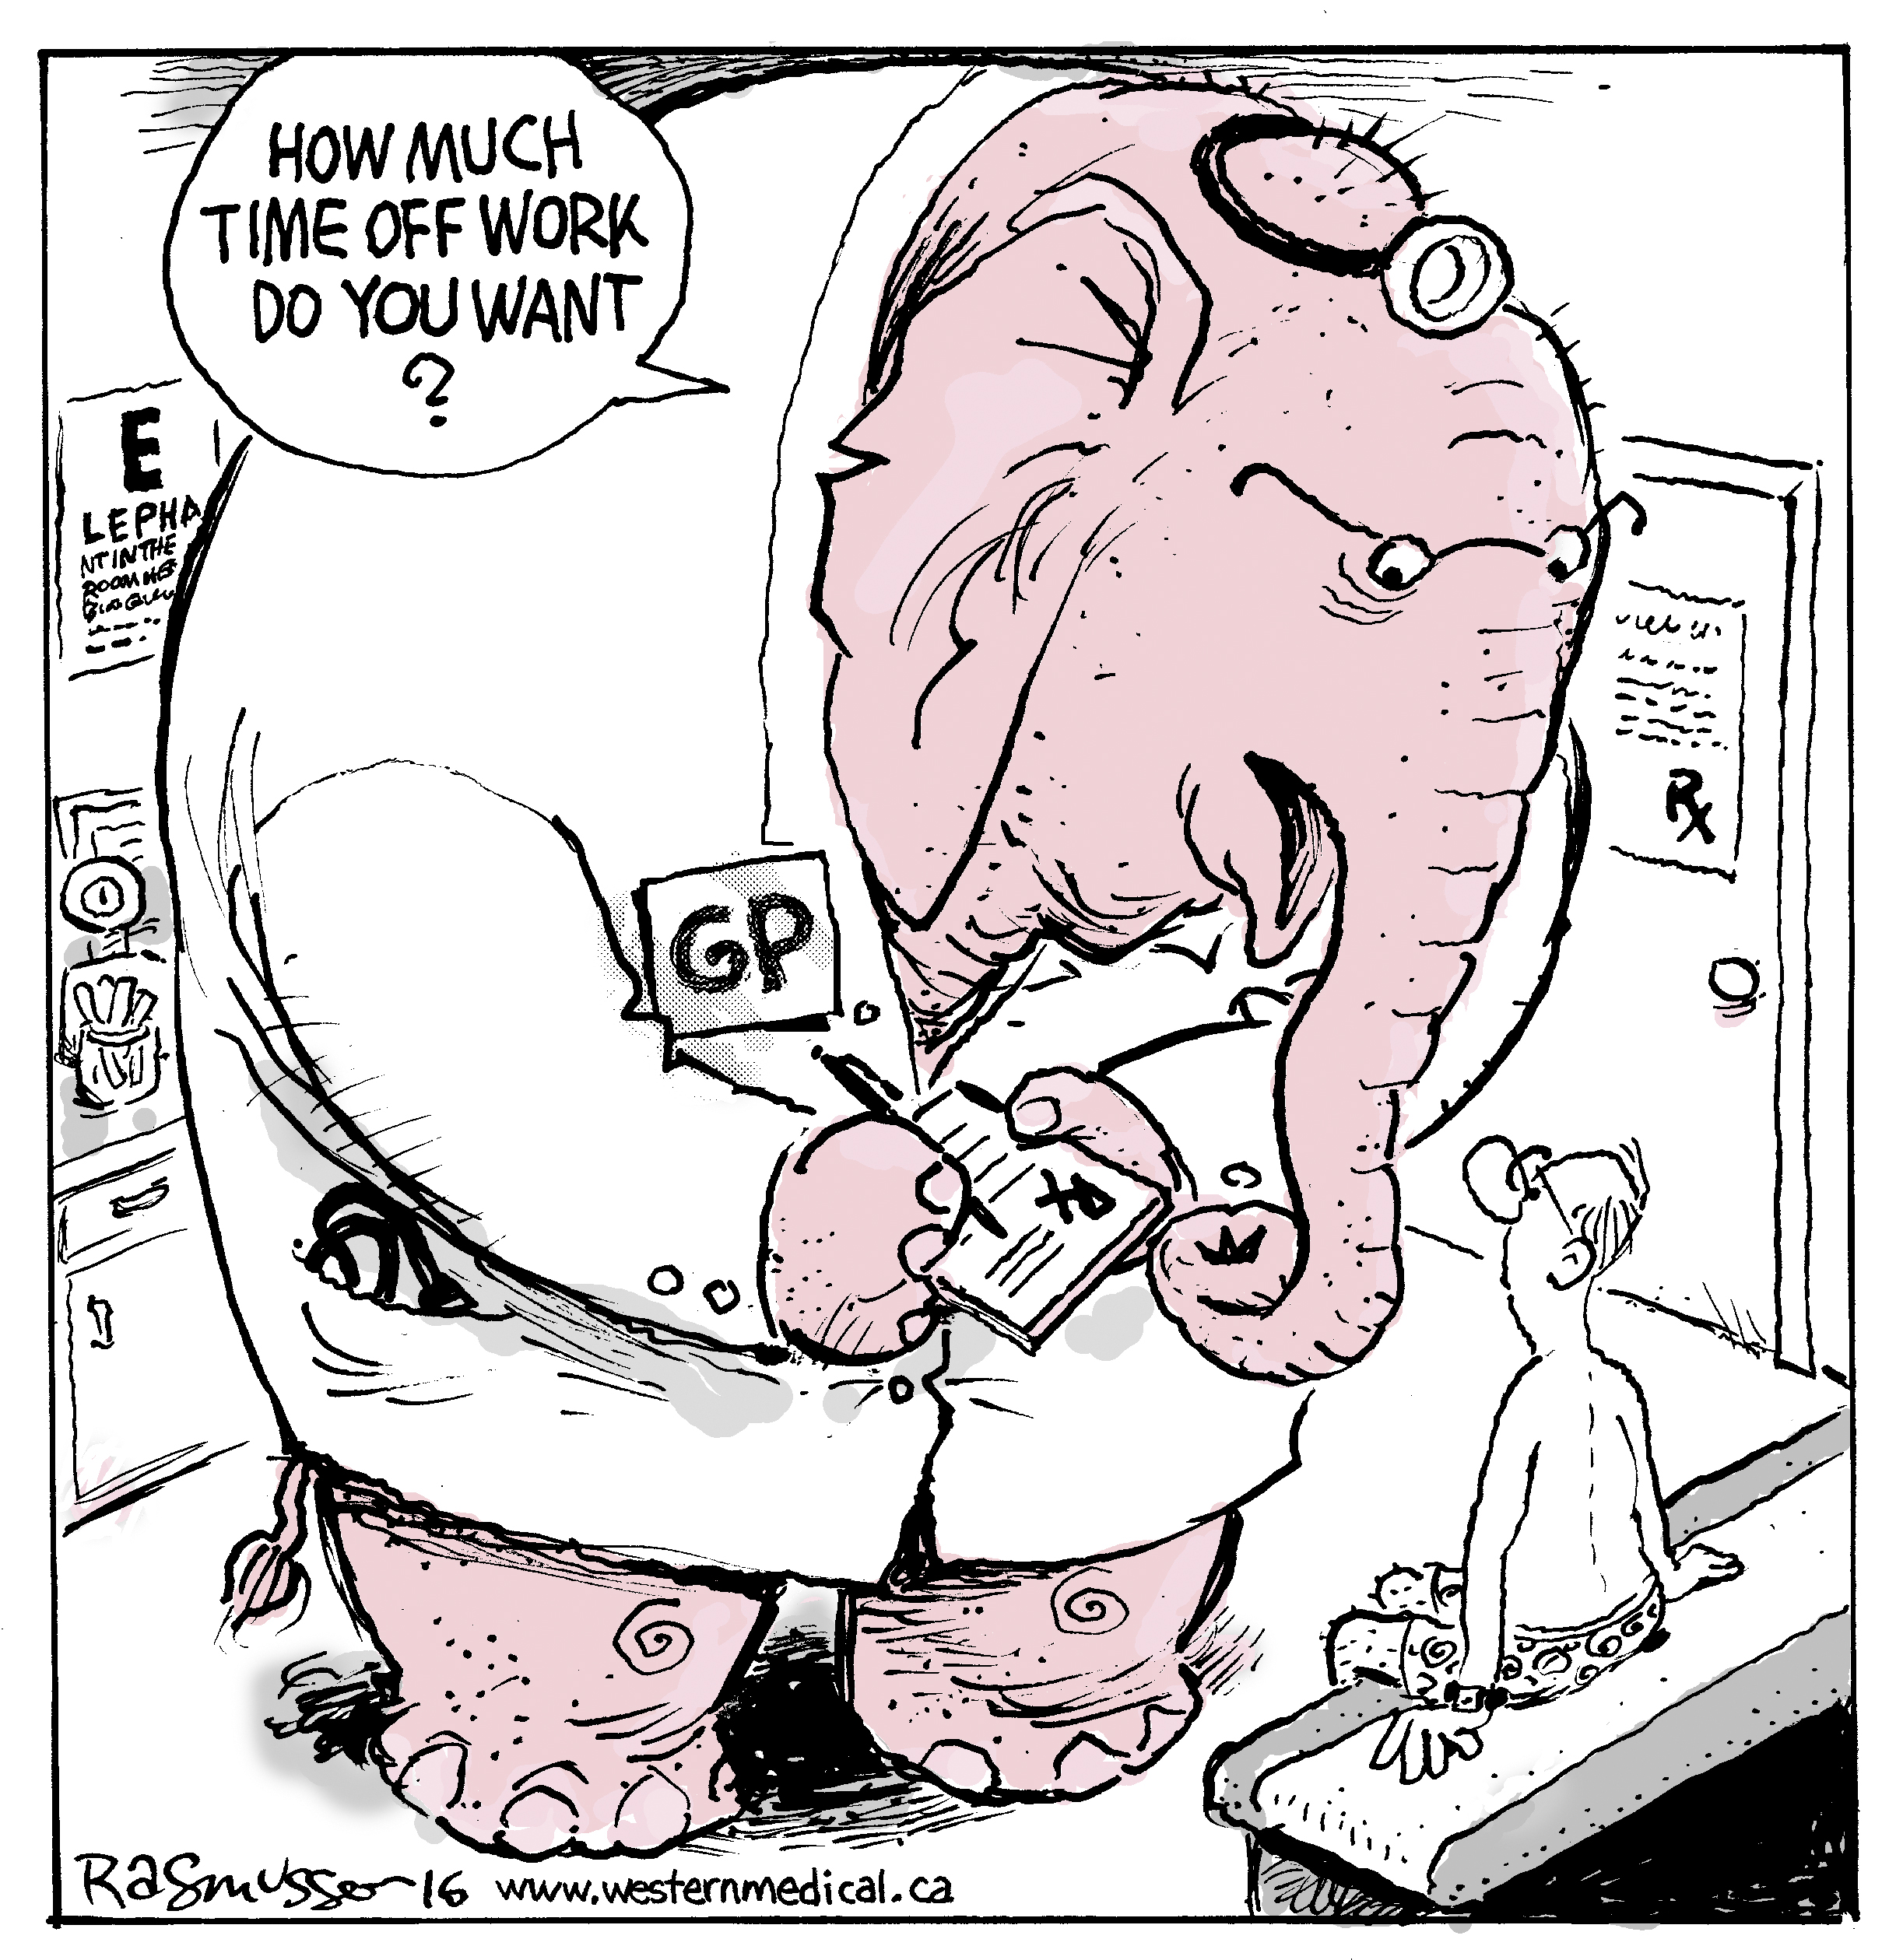
Notes:
500,000 absences / week
• approximately 355,000 disability cases due to mental and/or behavioral disorders
• approximately 175,000 full-time workers absent from work due to mental illness

Slide 13
RTW: Options #2
Wait for referral to specialist in the Public health system
Private health system; but how do you access?
Offload to ‘case monitoring’ company
Notes:
500,000 absences / week
• approximately 355,000 disability cases due to mental and/or behavioral disorders
• approximately 175,000 full-time workers absent from work due to mental illness

Slide 14
RTW: Option #3
OR … take control with Active Case Management
Information gathering is vital
Informal consultation with an IME company
Early intervention with an independent assessment
Notes:
500,000 absences / week
• approximately 355,000 disability cases due to mental and/or behavioral disorders
• approximately 175,000 full-time workers absent from work due to mental illness

Slide 15
TYPES of Medical Assessments
Independent Medical Examination (IME)
Performed by a physician specialist to determine diagnosis, causation, impairment, recommended treatment and prognosis
Tele-IMEs for psychiatric conditions
Claimant is remote; linked up by secure video portal to a psychiatrist in Edmonton
Functional Capacity Examination (FCE)
Performed by an occupational therapist or physiotherapist to determine degree of disability relative to the job description and recommend a safe RTW plan
Medical File Review (Document Review)
Performed by pertinent physician specialist in response to specific case management questions
No examination performed
Notes:
Many other types of medical assessments:
Job Demands Analysis
Cost of Future Care Assessment
Neuropsychological Assessments

Slide 16
PURPOSES of Medical Assessments #1
Rule OUT disease
Impossibility of proving an absence
Judgment: avoid further medicalization
Rule IN disease
Pre-event
Records: especially GPs
Return to pre-event condition
Post-event Injuries
Expediency
By-pass GP referral and public health system
Notes:
Many other types of medical assessments:
Job Demands Analysis
Cost of Future Care Assessment
Neuropsychological Assessments

Slide 17
PURPOSES of Medical Assessments #2
Diagnosis
Causation
Impairment / Disability
Prognosis for safe RTW
Investigation / Treatment Recommendations
Barriers
Credibility / Malingering
Notes:
Many other types of medical assessments:
Job Demands Analysis
Cost of Future Care Assessment
Neuropsychological Assessments

Slide 18
WHEN to use an IME
STD ➔LTD transition
Off work for 10+ weeks
Causation in doubt
Disputed rehab plan | Avoidance of ‘medicalization’
Safety for RTW
WCB Appeals
Cost-effective fast-track to a specialist

Slide 20
FCE Basics
By an Occupational Therapist or Physiotherapist
Examination for Disabilities Based on Job Description
Translation of Impairment into Functional Disability
Best Effort? >>> Malingering? Termination?
Recommended Active Treatment Program
Clinic-based vs. Home-based
Safe RTW Plan: F/T, P/T, Graduated, Modified Duties

Slide 21
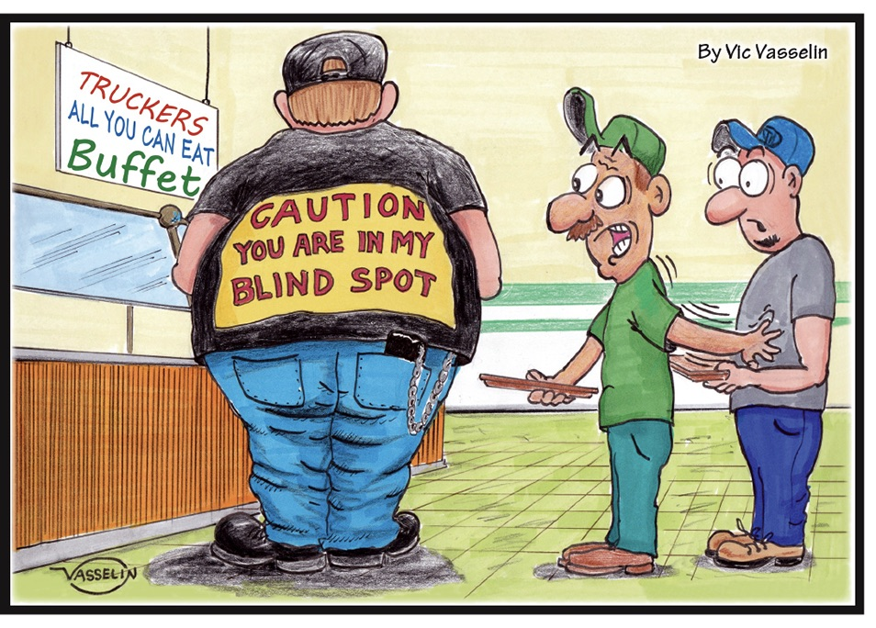
Notes:
500,000 absences / week
• approximately 355,000 disability cases due to mental and/or behavioral disorders
• approximately 175,000 full-time workers absent from work due to mental illness

Slide 22
Document Review Basics
Limited # of questions, typically:
Probable Diagnosis
Causation
Plausibility of Mechanism of Injury (e.g. WCB Claim)
Treatment Options
RTW Estimate
Prognosis
Barriers to Recovery

Slide 23
Document Review vs. IME
More documentation is better than less
Is it current?
Private opinion
Distant experts
Caveats
No access to NetCare or caregivers

Slide 24
WCB Challenges
WCB decisions can be successfully challenged with expert medical support
Early documentation!
Plausibility of causation
Role of pre-existing disease
Exacerbation vs. Aggravation
Post-event injuries
Recovery time

Slide 25
Safe RTW
IME
FCE
Document Review
Implementation:
Information to the GP -- ‘Evidence-based Empathy’
Consultant to manage the interaction of employer/employee/carrier/GP such as Impact HR
Notes:
500,000 absences / week
• approximately 355,000 disability cases due to mental and/or behavioral disorders
• approximately 175,000 full-time workers absent from work due to mental illness

Slide 26
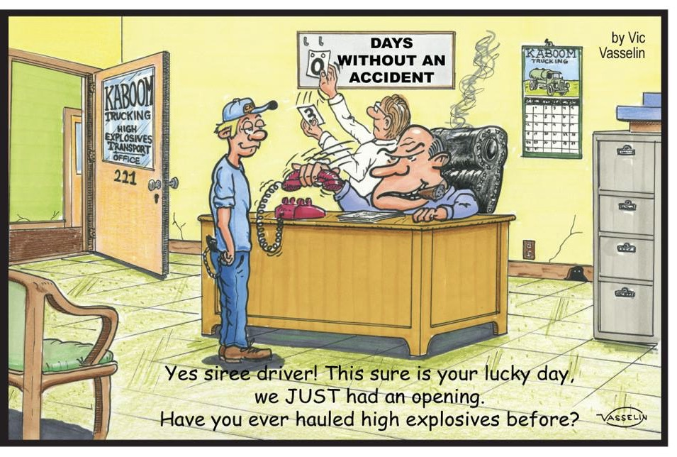
Notes:
500,000 absences / week
• approximately 355,000 disability cases due to mental and/or behavioral disorders
• approximately 175,000 full-time workers absent from work due to mental illness

Slide 27
Medicalization
GP
Chiropractor /Physiotherapy
Family / Society / Internet
Lawyers
3rd, 4th, 5th opinions: ‘Mayo Clinic Syndrome’
“If you have to prove you are ill you can’t get well.”
(Dr. Hadler, US Rheumatologist)
No surgery unless corroborating symptoms, signs and imaging
First, Do No Harm!
Notes:
500,000 absences / week
• approximately 355,000 disability cases due to mental and/or behavioral disorders
• approximately 175,000 full-time workers absent from work due to mental illness

Slide 29
Marijuana
‘Medical cannabinoid use should be limited; there is a potential restricted use for a small subset of medical conditions’
Simplified guideline for prescribing medical cannabinoids in primary care
Canadian Family Physician, February 2018
Notes:
500,000 absences / week
• approximately 355,000 disability cases due to mental and/or behavioral disorders
• approximately 175,000 full-time workers absent from work due to mental illness

Slide 30
Marijuana (cont.)
Indications
Position of the CMA and Canada Health
Latest dope on the regulatory framework
DATAC resource
Notes:
500,000 absences / week
• approximately 355,000 disability cases due to mental and/or behavioral disorders
• approximately 175,000 full-time workers absent from work due to mental illness

Slide 31
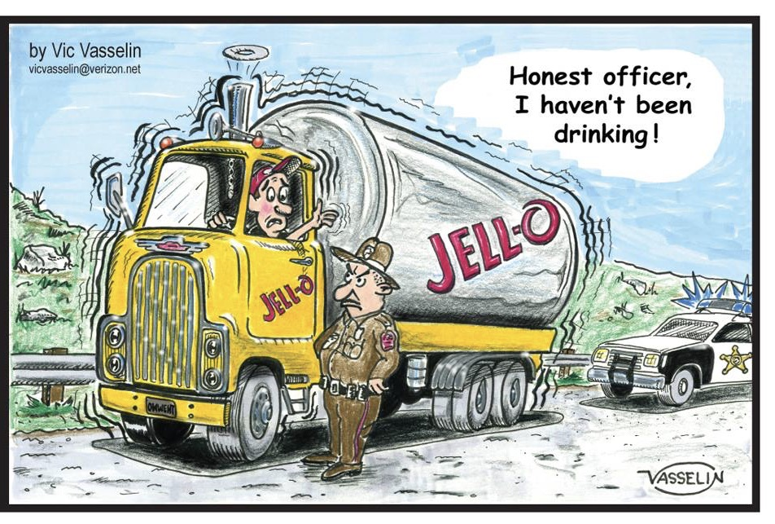
Notes:
500,000 absences / week
• approximately 355,000 disability cases due to mental and/or behavioral disorders
• approximately 175,000 full-time workers absent from work due to mental illness

Slide 32
Notes:
Canada now has the highest per capita narcotic use in the world --- higher than the US!

Slide 33
Opioids
“Treatment with opioids was not superior to treatment with non-opioid medications for improving pain-related function over 12 months. Results do not support initiation of opioid therapy for moderate to severe chronic back pain or hip or knee osteoarthritis pain.”
Effect of Opioid vs Nonopioid Medications on Pain-Related Function in Patients With Chronic Back Pain or Hip or Knee Osteoarthritis Pain
Journal of American Medical Association, March 6, 2018
Notes:
500,000 absences / week
• approximately 355,000 disability cases due to mental and/or behavioral disorders
• approximately 175,000 full-time workers absent from work due to mental illness

Slide 34
Opioids
Ineffectiveness in Low Back Pain – last resort
Dangers
Alternative measures:
home-based exercises
non-narcotic analgesics
mindfulness, yoga etc.
facet “blocks”
surgery
Notes:
500,000 absences / week
• approximately 355,000 disability cases due to mental and/or behavioral disorders
• approximately 175,000 full-time workers absent from work due to mental illness

Slide 35
‘3Ps’
PRODUCTIVITY + PREMIUM = PROFITABILITY
Notes:
500,000 absences / week
• approximately 355,000 disability cases due to mental and/or behavioral disorders
• approximately 175,000 full-time workers absent from work due to mental illness

Slide 36
Faster, Safer RTW Principles
Correct Diagnosis
Early Intervention
Evidence-based Treatment
Avoidance of Medicalization
Notes:
500,000 absences / week
• approximately 355,000 disability cases due to mental and/or behavioral disorders
• approximately 175,000 full-time workers absent from work due to mental illness

Slide 37
Summary
Early medical intervention radically changes outcomes
Medical Assessments provide:
Medical Clarity
Faster Resolution – Bypass public health system
Cost of active, evidence-based intervention is less than the total cost of passive case-monitoring
Better outcomes for employees’ self-esteem and the company
Informal consultations are key to navigating the medical labyrinth

Slide 38
“It is more important to know what sort of patient has a disease, than what sort of disease a patient has.” Sir William Osler Canadian Physician, 1849-1919

Slide 39
Notes:
500,000 absences / week
• approximately 355,000 disability cases due to mental and/or behavioral disorders
• approximately 175,000 full-time workers absent from work due to mental illness

Slide 40
FREE WEBINAR | Nov. 8 Driver Addictions, Low Back Pain & Fatigue A Roadmap for Best-Practices in Disability Management for the Transportation Industry
Notes:
500,000 absences / week
• approximately 355,000 disability cases due to mental and/or behavioral disorders
• approximately 175,000 full-time workers absent from work due to mental illness

Slide 41
Questions are Welcome!
Dr. Hodkinson personally responds to all confidential file questions. You can contact him at Western Medical Assessments: rhodkinson@westernmedical.ca
1-800.909.0577

Slide 42
Download Instructions
THIS PRESENTATION & WEBINAR REGISTRATION:

