Slide 1
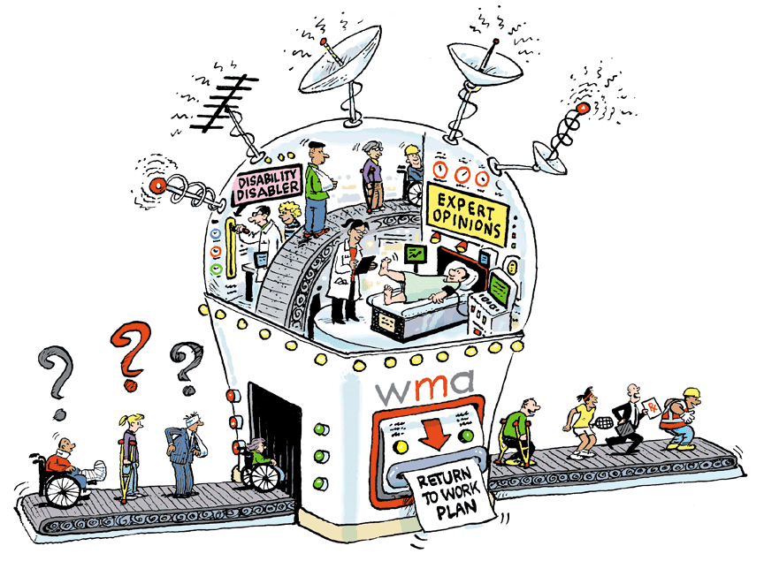

Slide 2
Document Reviews & Other Good Stuff!
Evidenced-based Clarity ™
Co-operators General Insurance Company
September 26, 2018
Dr. Roger Hodkinson, CEO & Medical Director Western Medical Assessments

Slide 3
“More important than the quest for certainty is the quest for clarity.” François Gautier
Evidenced-based Clarity ™

Slide 4
PURPOSES of Medical Assessments #1
Evidenced-based Clarity ™
Rule OUT disease
Impossibility of proving an absence
Judgment: avoid further medicalization
Rule IN disease
Pre-event
Records: especially GPs
Return to pre-event condition
Post-event Injuries
Expediency
By-pass GP referral and public health system
Notes:
Many other types of medical assessments:
Job Demands Analysis
Cost of Future Care Assessment
Neuropsychological Assessments

Slide 5
PURPOSES of Medical Assessments #2
Evidenced-based Clarity ™
Diagnosis
Causation
Impairment / Disability
Prognosis for safe RTW
Investigation / Treatment Recommendations
Barriers
Credibility / Malingering
Notes:
Many other types of medical assessments:
Job Demands Analysis
Cost of Future Care Assessment
Neuropsychological Assessments

Slide 6
WHEN to use an IME (see handout)
Evidenced-based Clarity ™
Off work for 90 days
Causation in doubt
Malingering
Disputed rehab plan | Avoidance of ‘medicalization’
Cost-effective fast-track to a specialist

Slide 7
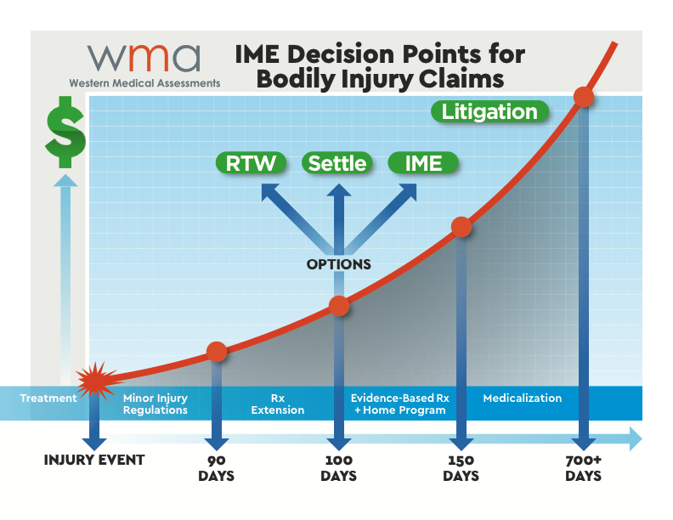

Slide 8
How to Use an IME Report
Evidenced-based Clarity ™
Option #1
Actionable items: approval/denial
Send report to GP:
Further investigation
Therapy implementation
Response to limitation/restrictions Qs
Option #2
Navigate the labyrinth with an outside consultant (not a case manager) to a coordinate interaction with:
insurance adjuster, lawyer, therapists, GP/specialist, referral/investigation, WCB, union, work supervisor, etc.

Slide 9
Document Review Basics
Evidenced-based Clarity ™
Limited # of questions for file management,
typically a mix of:
Probable Diagnosis
Causation
Plausibility of Mechanism of Injury
Treatment Options
Prognosis
Barriers to Recovery

Slide 10
WHY Use a Document Review?
Evidenced-based Clarity ™
Private response to specific case-management issues
Fast & Practical
Low Cost
Caveats
Opinion dependent on the quality of information
No corroboration with examination
May not be current status

Slide 11
Document Review vs. IME
Evidenced-based Clarity ™
Private opinion
More documentation is better than less
Is it current?
Distant experts
Caveats
No access to NetCare or caregivers

Slide 12
Evidenced-based Clarity ™
 | Document Reviews | IMEs | Tele-IMEs
Degree of Detail | Limited | Comprehensive | Comprehensive
Caveats | More | Least | Some
Private | Yes | No | No
Employee / Claimant Inconvenience | None | Some | Little
Speed | 1 Week | 2-3 Weeks | 2-3 Weeks
Medical Specialty | ALL | ALL | Psychiatry (only)
Fee | $ | $$ | $$
Notes:
Tele-IMEs are primarily used to assess psychological or psychiatric issues

Slide 13
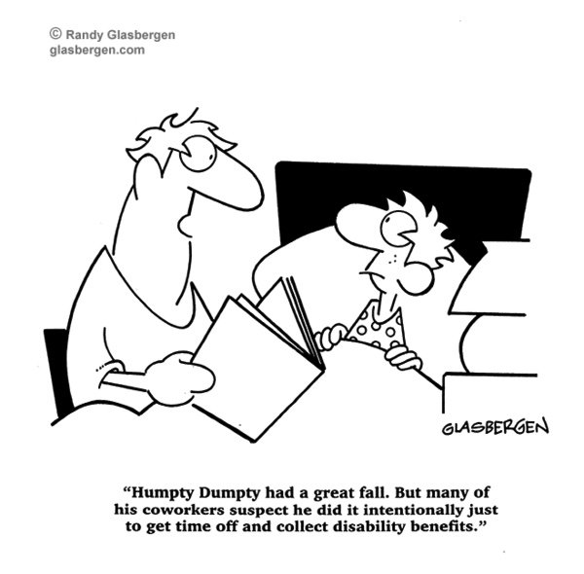

Slide 14
FIVE Frequently Confused Terms
Evidenced-based Clarity ™
Disease vs. Syndrome
Objective vs. Subjective

Slide 15
Evidenced-based Clarity ™

Slide 16
FIVE Frequently Confused Terms
Evidenced-based Clarity ™
Disease vs. Syndrome
Subjective vs. Objective
Exacerbation vs. Aggravation

Slide 18
Case Study #1 Exacerbation vs. Aggravation
Evidenced-based Clarity ™
59-year-old male plumber
Side impact MVA with intrusion at highway speed. Seat belt worn. Airbags deployed.
PMHx generalized osteoarthritis
c/o: acute onset left-sided chest pain. Chest X-ray showed an undisplaced left rib fracture. Tender over left chest wall.
Left-sided knee pain started 2 days after the MVA. On examination: painful ROM but negative for meniscus injury. No effusion. X-rays showed osteoarthritis of both knees but no fracture.
GP asks for approval for private MRI of the left knee

Slide 19
FIVE Frequently Confused Terms
Evidenced-based Clarity ™
Disease vs. Syndrome
Subjective vs. Objective
Exacerbation vs. Aggravation
Impairment vs. Disability
Restriction vs. Limitation

Slide 20
Medicalization
Evidenced-based Clarity ™
“Vague disability notes from GPs — or the ‘Elephant-in-the-room syndrome’ — are, in my opinion, the single biggest contributor to the massive cost of disability in Canada.”
Dr. Roger Hodkinson
‘4 Myths of Disability Management’
Canadian HR Reporter, Sept. 26, 2016
Notes:
500,000 absences / week
• approximately 355,000 disability cases due to mental and/or behavioral disorders
• approximately 175,000 full-time workers absent from work due to mental illness

Slide 21
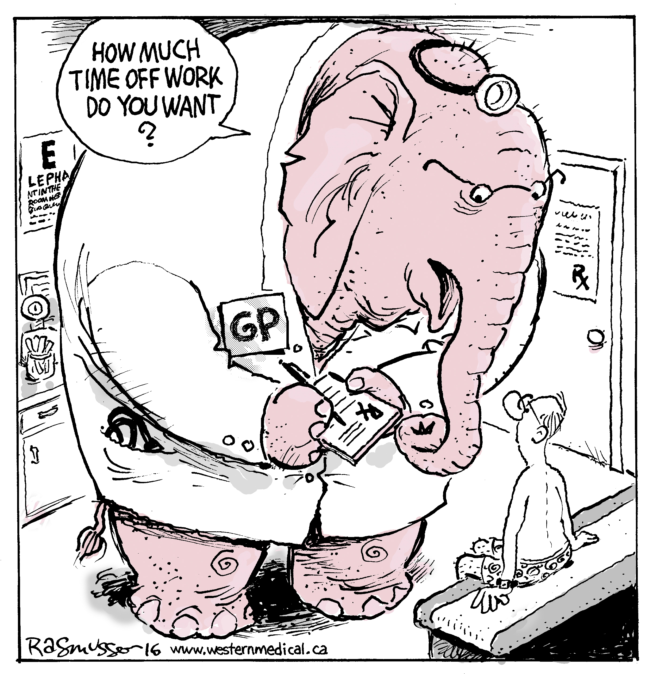
Notes:
500,000 absences / week
• approximately 355,000 disability cases due to mental and/or behavioral disorders
• approximately 175,000 full-time workers absent from work due to mental illness

Slide 22
Medicalization #2
Evidenced-based Clarity ™
Chiropractor /Physiotherapy
Family / Society / Internet
Lawyers
3rd, 4th, 5th opinions: ‘Mayo Clinic Syndrome’
“If you have to prove you’re ill you can’t get well.”
(Dr. Hadler, US Rheumatologist)
No surgery unless corroborating symptoms, signs and imaging
First, Do No Harm!
Medicalization E-Book (WMA website: ‘News & Events’)
Notes:
500,000 absences / week
• approximately 355,000 disability cases due to mental and/or behavioral disorders
• approximately 175,000 full-time workers absent from work due to mental illness

Slide 23
Evidence-based Treatments
Evidenced-based Clarity ™
Active physiotherapy
Non-narcotic medications
Mindfulness, yoga, etc.
Surgery
Placebos

Slide 24
Case Study #2 Non-Evidence Based Treatment
Evidenced-based Clarity ™
45-year-old female, single mother on welfare with three kids
Passenger in a minor rear-ender in a parking lot; $500 vehicle damage. Seat belt in use
PMHx Fibromyalgia, attempted suicide, depression
c/o: increased neck pain vs. before the MVA
Diagnosis: WAD lll by a physio
90 days after DOL physio requests another 12 treatments. Adjuster refuses to approve. Claimant gets represented and lawyer says WAD lll is not a Minor Injury and sues for bad faith
Was it a WAD lll from the start?

Slide 26
Case Study #3 | Marijuana
Evidenced-based Clarity ™
60-year-old male truck driver, hits deer at night. Seat belt in use.
PMHx: Chronic Low Back pain. Obesity. Depression.
c/o: Sudden increase in low back pain without radiation
0/e: No objective neurological signs. Diagnosis: back strain
Off work for two months. Passive physio, chiropractic and massage with limited benefit.
GP starts him on medical marijuana, but employer refuses a RTW due to safety issues and refers him to an orthopedic surgeon. Still off work.

Slide 27
Marijuana
Evidenced-based Clarity ™
‘Medical cannabinoid use should be limited; there is a potential restricted use for a small subset of medical conditions’
Simplified guideline for prescribing medical cannabinoids in primary care
Canadian Family Physician, February 2018
Notes:
500,000 absences / week
• approximately 355,000 disability cases due to mental and/or behavioral disorders
• approximately 175,000 full-time workers absent from work due to mental illness

Slide 28
Marijuana #2
ax
Evidenced-based Clarity ™
Indications
Nausea and vomiting of chemotherapy
Rare forms of pediatric epilepsy
Spasms in multiple sclerosis
Position of the CMA and Canada Health
Latest dope on the regulatory framework
DATAC resource
Notes:
500,000 absences / week
• approximately 355,000 disability cases due to mental and/or behavioral disorders
• approximately 175,000 full-time workers absent from work due to mental illness

Slide 29
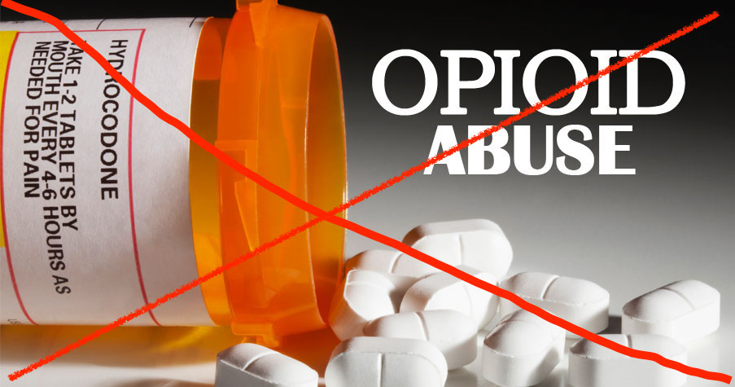
Notes:
Canada now has the highest per capita narcotic use in the world --- higher than the US!

Slide 30
Opioids
Evidenced-based Clarity ™
“Treatment with opioids was not superior to treatment with non-opioid medications for improving pain-related function over 12 months. Results do not support initiation of opioid therapy for moderate to severe chronic back pain or hip or knee osteoarthritis pain.”
Effect of Opioid vs Nonopioid Medications on Pain-Related Function in Patients With Chronic Back Pain or Hip or Knee Osteoarthritis Pain
Journal of American Medical Association, March 6, 2018
Notes:
500,000 absences / week
• approximately 355,000 disability cases due to mental and/or behavioral disorders
• approximately 175,000 full-time workers absent from work due to mental illness

Slide 31
Opioids
Evidenced-based Clarity ™
Ineffectiveness in Low Back Pain – last resort
Dangers
Alternative measures:
home-based exercises
non-narcotic analgesics
mindfulness, yoga, etc.
facet “blocks” – little evidence
surgery – if corroborated with objective neurological signs + corresponding imaging

Slide 32
Waddell’s Signs #1
Evidenced-based Clarity ™
Tenderness - Diffuse/superficial
Simulation - axial loading
Distraction
Rotation
Straight leg-raising
Non-anatomic sensory changes/motor (e.g. loss of sensation in an entire limbs)
Overreaction - grimacing

Slide 33
Waddell’s Signs #2
Evidenced-based Clarity ™
Meet 3/5 = NOT Organic
Does not necessarily = malingering
Causes:
emotional disturbance
"no one believes me"
malingering

Slide 34
“It is more important to know what sort of patient has a disease, than what sort of disease a patient has.” Sir William Osler Canadian Physician, 1849-1919
Evidenced-based Clarity ™

Slide 35
Summary
Evidenced-based Clarity ™
Early medical intervention radically changes outcomes
Document/File Reviews:
Provide Medical Clarity at important decision points
Faster Resolution – Bypass public health system
Low cost
Cost of active, evidence-based intervention is less than the total cost of passive case-monitoring
Informal consultations can be very helpful

Slide 36
Evidenced-based Clarity ™
WHEN: Oct. 25 (Thursday) 1:30 p.m. – 4 p.m.
WHERE: Shaw Conference Centre (Salon 4)
COST: FREE (with advance online registration)
CREDITS: Alberta Insurance Council
REGISTER: WesternMedical.ca (top of home page)

